Slide 1

Azure NoSQL offerings
Use Cases, and Relative Performance and Costs
12 Mar 2019
Galena Hill Systems

Slide 2
Agenda
Azure SQL Baseline
Blob Storage (Block, Page and Append)
Table Storage
Storage Queues (Versus Service Bus vs Event Hubs vs Event Grids)
CosmosDB - API's for MongoDB, Cassandra, Gremlin and Table Storage
Azure Redis

Slide 3
Scope + limitations of this presentation
Disclaimers:
Operational Focus – i.e. Excludes Analytic, notably Hadoop (Azure HD Insights) and Azure Data Lake
Azure `Managed` Focus – i.e. Note that you always have the option of spinning up your own VM or Container and running a best-of-breed product (e.g. MongoDB, Cassandra, Riak, ElasticSearch etc). But then you need to consider redundancy, backup, software upgrades etc.
Approaching this from a Start-Up point of view – we are cost sensitive– will be focussing on the lower end of the cost and performance spectrum
Notes:
There are literally 1000’s of permutations for storage options, tiers, regions etc etc
Any figures are rough guide only / not official Microsoft
Costs will vary over time / region
Costs are given in USD

Slide 4
`NoSQL` vs SQL
SQL Legacy:
15+ Years ago SQL was the ubiquitous database, and perhaps a few loose files on a file server, or a cache
Features of SQL Databases
  `ACID` transactions.
  Centralized data. Distributed scale achieved typically by read-only slaves or data sharding.
  Data is Strong Schema
  Referential Integrity
  Data can be JOINED
  Programmable (SPROCs, Functions, Triggers etc)
Problem : Scalability! (Need to move toward “P” of CAP)
We’ll lose some, or all of the above features when moving data to NoSQL – our mindset needs to change
NoSQL databases tend to favour `Partition` ability, and will trade off on Consistency or Availability
There are so many different types of `NoSQL` databases, that it’s criminal to ‘lump’ them as “NoSQL”
Notes:
Accustomed to the ACID way of life

Slide 5
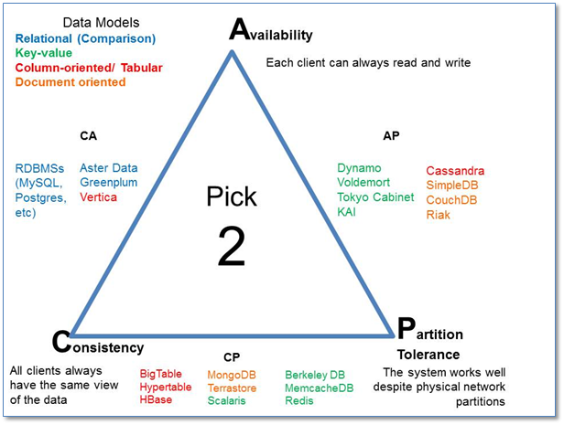
CAP Theorem
Image Courtesy : https://blog.flux7.com/blogs/nosql/cap-theorem-why-does-it-matter
Notes:
The dreaded CAP triangle – pick any 2, but you can’t have all 3.
SQL Relational Databases play along AC
Most of the NoSQL offerings are CP
For example applying CAP to SQL
In order to scale SQL, we need to shard it (e.g. Surnames starting A-M in one Shard, and N to Z in another).
However we either lose the ability to commit data transactionally across both Shards (i.e. we lose the “C”)
OR, if we take a monster distributed DTC or XA lock across the Shards (so we get “C” back), then we’re going to lock people out of data during the transaction, meaning we lose the “A”

Slide 6
SQL Demo – 5 DTU ☺
i.e. What kind of Azure SQL database can I do for $5 per month
Notes:
Quick Demo – this is on the 5 DTU
Insert 1000 Rows (=2MB)
Note that 1024 byte strings, NVARCHAR = 2k / row.
200MB in ~430seconds ~470kB/s
Running same demo on SQL Express local on Prem -> 200MB in ~7.5 seconds (@27MB/s)

Slide 7
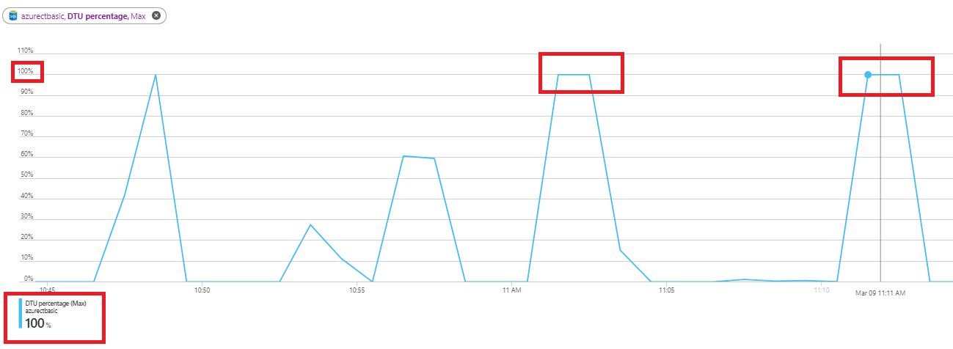
Azure SQL – Baseline I/O
SQL BulkInsert 100k rows of 1024 NCHAR, single thread (~200MB)
  Writing to a Local On-Prem SQL Express takes ~7 seconds (> 25MBps)
Cheapest Azure SQL Database is “Basic” @ $5 / month
  Same 100k rows ~ 500 seconds!!! (~500kBps)
DTU is a ‘combo’ of I/O, Memory and CPU usage. 1 DTU ~12.5 IOps
Notes:
So the reason why our 5 DTU database is so slow is because the IO (and CPU + Memory) is deliberately capped

Slide 8
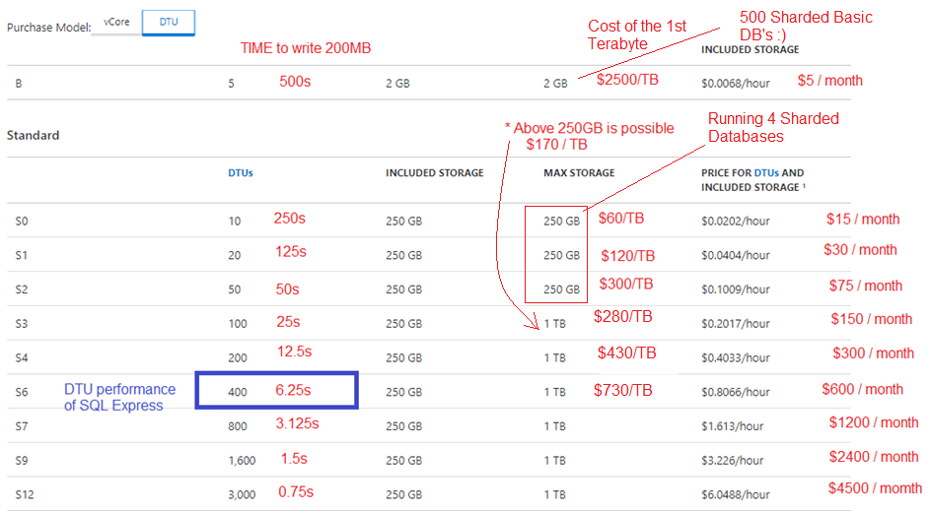
Baseline Cost – SQL DTU IO and Storage
Notes:
Our SQL Express on prem performance (27MBps) is between S4 and S6
S0 is actually quite attractive - $15pm for 250GB isn’t bad, and if we can do a 4 shard S0 configuration, we get 1TB and up to 3MBps throughput for $60pm

Slide 9

SQL can be overkill for many situations?
Notes:
So SQL is great, but not the solution for all data problems

Slide 10
Azure Storage Accounts
Pay for actual Storage, and actual I/O (Serverless I/O, although storage not entirely free)
Files
  Implementation of the Server Managed Block (SMB) protocol
Managed Disks
  HDs and SSD’s for VMs / VHD From $1.50 / mo for 32GB @ 60MB/s
Blobs
  Block – e.g. Discrete Files – atomic overwrite and replace (Key Value Store)
  Page – File Systems, and VHD type usage (pre allocated, random access)
  Append – e.g. Logs
Storage Queues (FIFO Storage)
  ?Point-point integration (although would suggest Service Bus, Event Hubs for enterprise integration)
  Queued local Work
Table Storage
  Structured Columns
  Primary Indexing on Partition Key + Row Key
  No Joins between Tables
  No Secondary Indexes
Notes:
Storage Queues should be thought of more as FIFO storage rather than as “middleware”
https://docs.microsoft.com/en-us/azure/service-bus-messaging/service-bus-azure-and-service-bus-queues-compared-contrasted
Life hack : Most of the Azure Clients are stateless (they are just REST clients) and thread safe, so sharing a singleton instance or even binding to a single static instance should reduce overhead in your app : https://docs.microsoft.com/en-us/azure/azure-functions/manage-connections#static-clients

Slide 11
(Block Blob Demo)

Slide 12
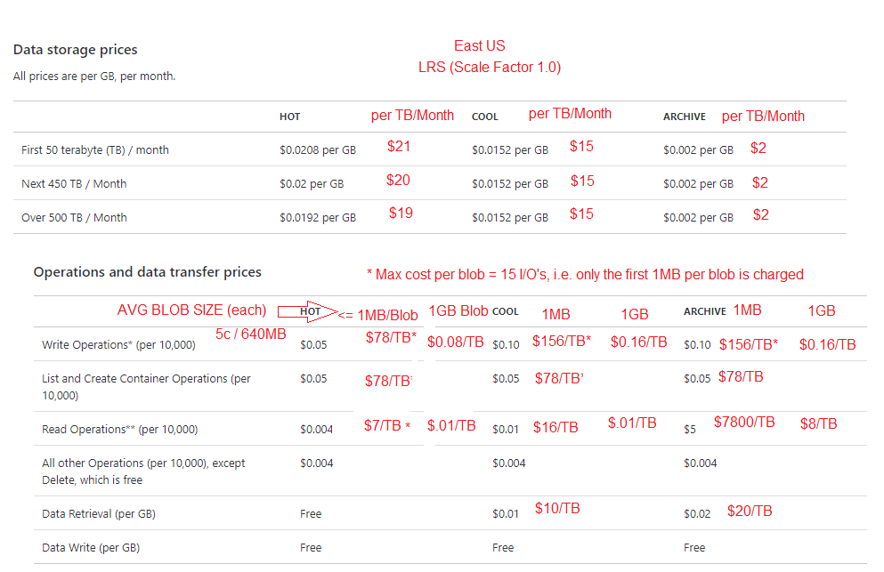
Cost – Block Blob Storage + I/O
Notes:
Need to monitor the read, and write I/O operation costs – they can clock up.

Slide 13
Azure Storage - IO Throughput and Limitations
Max Storage / Storage account : 500 TB
Max Blobs, Containers, Messages, Tables, etc : Unlimited (but see size)
Rate : 20 000 requests / second
Peak Ingress (write): 20Gbps LRS/ZRS, 10GBps GRS
Peak Egress (read): 10Gbps to 50Gbps (dep region, redundancy etc)
(i.e. should be able to get peak throughput somewhere above 1GB per second)
Notes:
Basically, with the Storage offerings, transfer rates are really good after some coding effort (i.e. parallelizing, multiple connections, and bulk / batch insertion).
Storage costs are generally cheaper than SQL, but we also pay for all IO.

Slide 14
Blob Storage – Cost Summary
Storage Redundancies (and Price Factor)
  1.00 LRS (Eleven 9’s availability) – at least 2 copies, same DataCentre
  1.25 ZRS (Twelve 9’s – copies in at least 2 DataCentres
  2.10 GRS (Sixteen 9’s) – Asynchronously replicate to a second region
  2.75 GRS-RA – As above, but allows reads from the slave region
  Also both GRS flavours cost extra $.02 per GB for regional replication
Storage Flavours
  Hot –50% cheaper Reads (Cheaper I/O, Higher Storage) (not faster reads!)
  Cold – Cheaper Storage
  Archive – Offline storage – Super cheap Storage, but crazy expensive and slow (hours!) to bring back online
  Premium (SSD) – Still in preview, looks like a Flat rate of $75/TB/Mo, with negligible data I/O costs
I/O
  If you have lots of read I/O, but relatively smaller Storage needs => Use Hot
  I/O costs are capped at 15 IO ops (64kB per IO), so blobs >> 1MB are cheaper

Slide 15
Blob Storage – Block Blobs
Key Value Store – Use Cases for Storing Files, Images, Media
Blobs are stored in Containers
No container nesting (“subfolders”), but you can use `/` in your container names which give a similar same effect.
“Query” functionality is typically limited to container and key – Exact Container + Key, or List all Blobs in a Container

Slide 16
Azure Table Storage
Primary Key is a composite of (Partition Key, Row Id)
Strong schema – columns have fixed type
Can do “Row Key” .StartsWith Scans in <= O(Log N)
Can do arbitrary column filters, but this is O(N) per partition (Partition scan) or in total (Table scan)
Limits:
  500TB / Table
  1MB limit per row
  64kB limit per column
  252 Properties (+3 mandatory – Timestamp, PartitionKey, RowKey)
Throughput
  ~2000 rows / second / partition (1kB Rows)
Notes:
Important to note here is that we’re just using one thread – we can easily parallelize the batch writes to each partition.

Slide 17
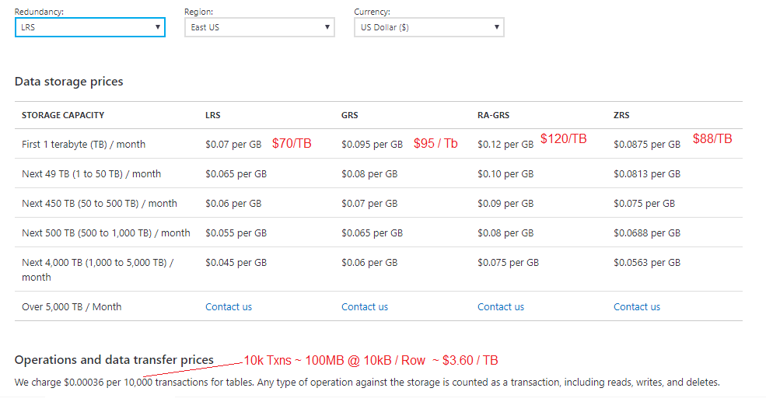
Table Storage - Cost

Slide 18
Azure Queue Storage
(Demo)

Slide 19
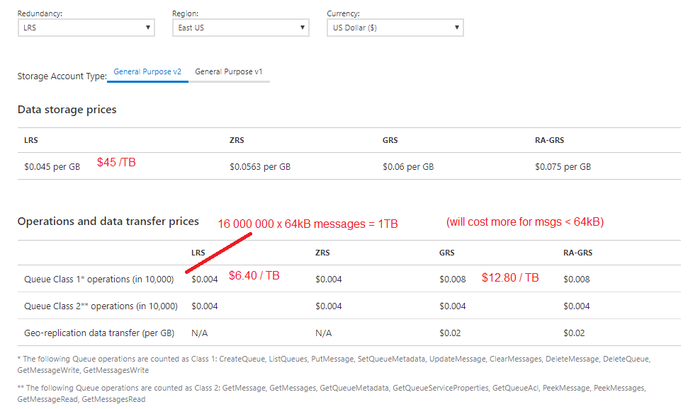
Queue Storage Costs

Slide 20
Azure CosmosDB
Back to the “Fixed Cost” model – this time, “Request Units” (RU’s) govern the pricing, plus additional cost per GB storage
Minimum is 400RU, increments of 100RU’s
1 RU ~ throughput of 1kB per second
Provision throughput either at Container, or Database Level
  Database level provisioning spread across containers
  Need a min of 100RU’s per Container
During queries, sub-selecting / Projecting only the required part of a document optimized RU usage
Gotchas
  10GB Max per Partition in each Collection – use a partition key (shard key) carefully
  Max Document Size = 2MB (MongoDB native is 16MB)
  Selecting across partitions can be expensive, especially if ordering
Notes:
i.e. with 400 RU’s provisioned at the database level, max of 4 containers
MS say min Database level provisioning is 400? Vs 10000?
https://docs.microsoft.com/en-us/azure/cosmos-db/set-throughput#comparison-of-models
If Database provisioning is prohibitive, is a hack to put everything in one container, with an indexed ‘type’ discriminator : https://medium.com/@david.nissimoff/azure-cosmos-db-like-a-pro-minimize-cost-maximize-productivity-24dfee205c0
10GB Max Partition : https://stackoverflow.com/a/48037647/

Slide 21
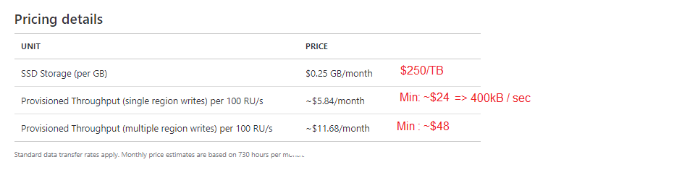
CosmosDB – Pricing

Slide 22
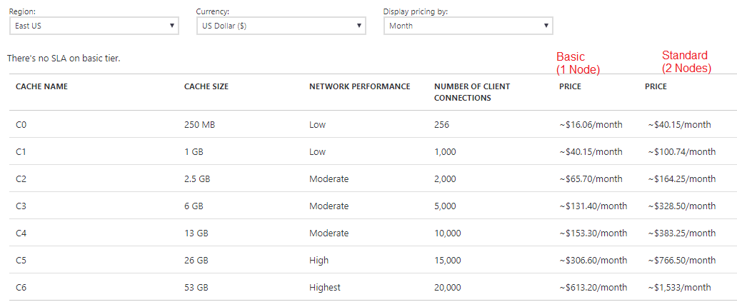
Azure Redis
Redis as a cache … (non-persistent)
Notes:
This would be the common use case for Redis – Secondary Caching, using Redis as a Key Value store.
We’re paying for memory and fast network here.
Clients will use connection pools, so can stretch the client connections.
The aim here is very low latency. Throughput isn’t as important.
Cache miss pattern - an app looks in Redis for the data – if it’s present in Redis, can save the round trip to slower SQL or NoSQL databases in the back end.
Mention eviction and retention policies to Redis – it’s quite an art form trying to keep the most probable data in the cache.
Tip : Serialization isn’t free – if you can store a JSON string and then simply serve the string to an AJAX client using Content Headers, profit!

Slide 23
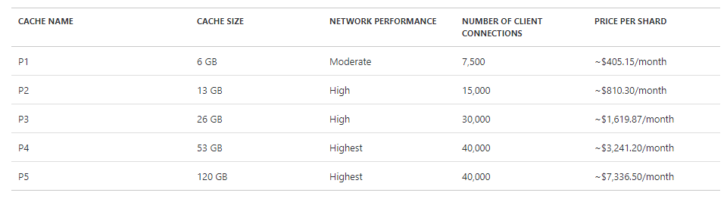
Azure Redis as Persistence
Redis Premium - Multiple Nodes, and Persistence
Notes:
Redis persistence seems a luxury, but there are likely use cases in premium apps where can’t afford to reseed the cache from scratch etc.

Slide 24
Comparing Apples, Pears and Oranges
Write performance and per TB summary:
SQL S0: Min $60 per TB/month + 0 IO @ 750kB /s per Shard
Block Blob Cool : Min : $15 per TB + X /TB/ Month @ > 40MB/sec (1 thread)
Table Storage : $70/TB + $3.60 / TB @ > 2MB/s (1 thread)
CosmosDB : $ / TB + $24 @ 400kB / sec * (Most I've got is around 330kB/s) 250
And if you want your whole 1TB Persisted in Redis …
~$56 000 pm … but you get 250k requests / second and likely insanely low latency
Notes:
Some “life hacks”
S0 is a sweet spot - 4 Shards of S0 DTU based SQL databases gives 1TB of storage and up to 3MB/s of throughput. Not bad for $60!
Block Blobs – the bigger the blob, the cheaper it gets.
CosmosDB – Managed Mongo, Gremlin, but will pay for throughput
Redis – Keep your high access mutable data here (or larger scale immutable data).
Bonus : If you have small amounts of truly immutable data, load them up into a dictionary on App bootstrap. Very slow changing data, e.g. Countries, Provinces, Currencies etc can also be loaded up as immutable in your apps, and then reloaded once every X hours (e.g. 24 hours)

Slide 25
More Disclaimers - What we’ve blatantly ignored
Focus on Throughput, not on Latency
  In Memory Caches like Redis will dominate here (<<1ms), but Mongo is pretty good too
Data Integrity + Schema Enforcement - Strong (SQL + Table Storage) vs Weak Document (e.g. Mongo) vs None (Blob)
Where to play on the CAP theorem (ACID, Partitions, Availability, etc)
Secondary Indexing. SQL and Cosmos support Secondary Indexes.
  NoSQL typically encourages storage of secondary projections with different keys, i.e. additional storage
Additional “Server” functionality
  SQL is programmable. MongoDB allows JS MapReduce and Aggregation Pipeline scripts
Notes:
i.e. before everyone hares off moving their financial accounting LOB SQL database across to Table Storage, lets just stop for a second

